Slide 1


Geospatial study of Airbnb distribution on different states of USA
Team Members :
Zahraa AI Haj Hasan
Nikhil Teotia
Priyanka Choubey

Slide 2
Searching of Dataset: Nikhil Teotia
Identifying problem statements – all 3 team members.
Data cleaning:
For year 2020- Priyanka
For Year 2023 – Zahraa
Data modelling: Zahraa
Modelling techniques:
Linear regression, Decision Tree – Priyanka
Logistic Regression, Neural network – Nikhil
Future price prediction – Zahraa
Visualization Reports:
For Year 2020: Priyanka
For Year 2023: Nikhil Teotia
Final dashboard: Zahraa
Presentation Creation: Priyanka Final report: Nikhil Teotia

Slide 3

What is Airbnb?
It a service that let Property owners rent out their spaces to the travelers from different part of world.
Since 2008, Guest and host have used Airbnb to expand on travelling Possibilities and present a more unique ,personalized way of experiencing the world.
This is peer-to-peer business model. This makes it simple, easy to use, and trends to be more profitable for both side.

Slide 4


Project Purpose
For this Project we chose Airbnb’s of different cities in United State during 2020 and 2023.
The purpose of the project is to give a Perspective to the owner of a house who potentially willing to renting out a room. Give Insite about develop an effective pricing strategy that aligns with the local real estate market, considering factors such as property features, neighborhood demand, and guest preferences. The goal is to optimize the property's rental potential while maintaining competitiveness in the market.
For business Perspective individuals planning to buy a house, the challenge is to identify neighborhoods with high demand and revenue potential. This involves analyzing various factors, including local market trends, property value growth from 2020 to 2023, and key amenities in different areas. The objective is to make informed decisions on where to invest based on future growth prospects and current market dynamics.
This Photo by Unknown Author is licensed under CC BY

Slide 5
Describe the Dataset and its source
Column | Description
id | Airbnb's unique identifier for the listing
name | Name of the listing
host_id | Airbnb host's unique identifier
host_name | Name of the host
neighbourhood_group | The neighbourhood group as geocoded using the latitude and longitude against neighborhoods as defined by open or public digital shapefiles.
neighbourhood | The neighbourhood as geocoded using the latitude and longitude against neighborhoods as defined by open or public digital shapefiles.
latitude | Latitude in the World Geodetic System (WGS84) projection
longitude | Longitude in the World Geodetic System (WGS84) projection
room_type | Type of room (e.g., entire home, private room, shared room)
price | Daily price in local currency (Note: $ sign may be used regardless of locale)
minimum_nights | Minimum number of nights required for the listing (calendar rules may vary)
number_of_reviews | Total number of reviews the listing has received
last_review | Date of the last/newest review
calculated_host_listings_count | Number of listings the host has in the current scrape, in the city/region geography
availability_365 | Availability of the listing x days in the future as determined by the calendar. Note: A listing may be available because it has been booked by a guest or blocked by the host.
number_of_reviews_ltm | Number of reviews the listing has received in the last 12
Dataset: https://www.kaggle.com/
Source : http://insideairbnb.com/get-the-data/
These Columns are Initial Columns for both the data set 2020 and 2023

Slide 6

Data Preparation
226030, 17
Data Cleaning:
For this process Phyton was used and the step to clean the datasets of 2020 and 2023 is:-
2020:-
Handling Missing Values by checking the missing value and checking the percentage of missing value and use fillna function method fill the null values with appropriate values. Then check the Outlier using box plot. Then remove the outliers and recheck again with the missing value and outliers. Check the duplicate values using duplicate functions. Describe the data set and create the pair plot to check the further modeling process.
2023:-
Handling Missing Values by checking the missing value and checking the percentage of missing value and use fillna function method fill the null values with appropriate values Then remove the outliers recheck again . Check the correlation to do the further modeling Process.

Slide 7

Data Exploration
226030, 17
ETL Process:
Extract both data set 2020 and 2023 in .xlsx format in power BI because its comma separated when we take it to Power BI it treats delimiter with numbers and give us error. We used DAX query in power BI to create new columns and bin which help to give clear insights in visualization. Explain in detail :-
booking_flexibility=[minimum_nights]/[availability_365])
reviews_ratio = [reviews_per_month]/[number_of_reviews])
price_reviews_ratio = [price]*[reviews_ratio])
price_range", if [price] < 100 then "economic" else if [price] < 150 then "low-mid" else if [price] < 200 then "high-mid" else "high")
Added Conditional Column", "availability", if [availability_365] < 90 then "low" else if [availability_365] < 180 then "medium" else if [availability_365] < 270 then "high" else "very high")
"popularity_index", if [popularity] > 6 then "high" else if [popularity] > 3 then "medium" else "low"
booking_flexibility_index", if [booking_flexibility] > 6 then "low" else if [booking_flexibility] > 3 then "medium" else "high"

Slide 8
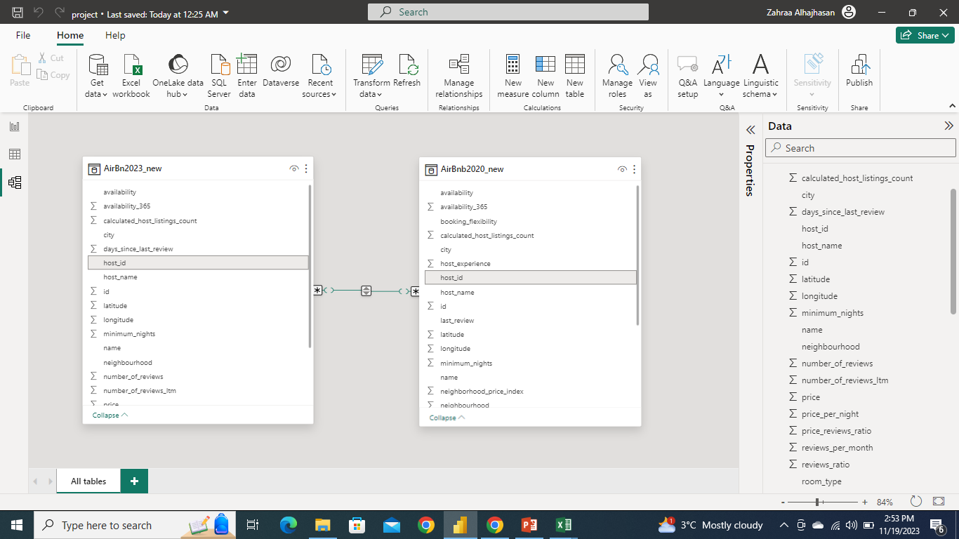
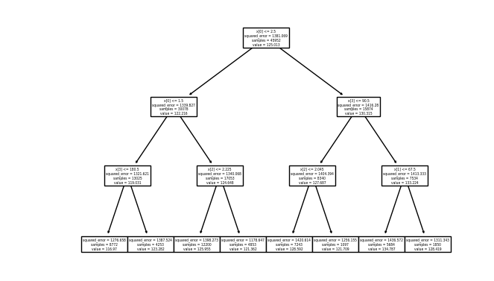
Data Modelling
In 2020 Dataset Python was used in Linear regression, Decision Tree as Modelling techniques And check the mean_absolute_error mean_absolute_error approx. 31%
In 2023 Dataset also used Linear regression, Logistic Regression Data Modelling.

Slide 9
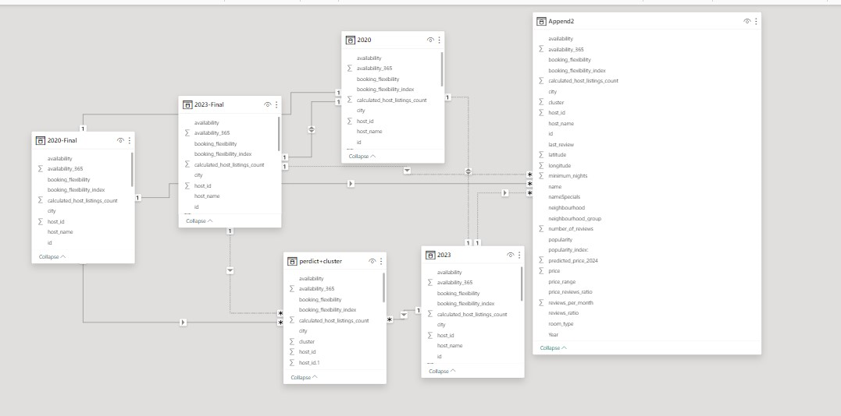
Data Modelling
We choose Power BI to join two dataset from different years
It was tricky joining the 2 data sets as we are losing on some data because data is not consistent between the 2 datasets. Initially we try to create a union on the bases of year. But after removing some duplicate values from id field The most accurate parameter to join the 2 tables is id field.

Slide 10

Visualization
Use ArcGIS map to mark the location points
Clustered Bar Chart displays multiple bars grouped in clusters to compare different categories across different groups.
Decomposition Tree breaks down a total value into its contributing factors across multiple levels.
Line Chart represents continuous variable, while the values being measured.
Donut Chart: Represents data as sectors of a circle.

Slide 11

Visualization Queries
1.How many Airbnb’s listing in each city?
What are the top 10 most frequently reviewed listings in a specific neighborhood?
Can provide a breakdown of neighborhoods based on different price ranges along with the corresponding number of listings in each?
How has the growth in the number of listings and reviews evolved throughout the year within each pricing range?
What is the average number of listings managed by individual hosts in a particular city?
What is availability by Room Type?
What type of property best fits the user's needs and preferences?
Number of Reviews average changes buy minimum Nights?
List of top rated and least rated Host

Slide 12
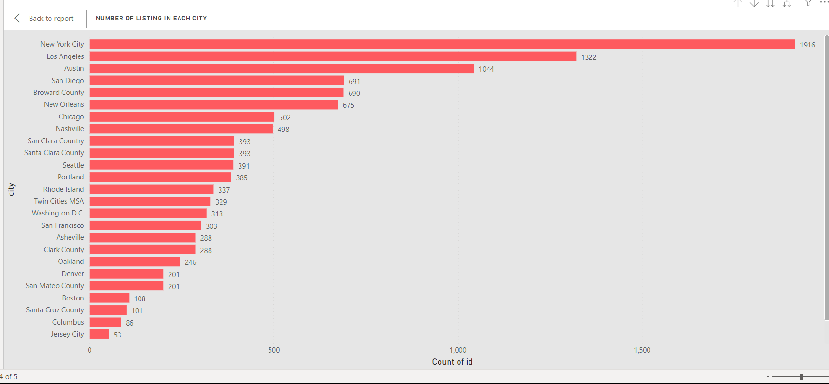
Airbnb’s listing in each city
New York City has the highest listings which is approximately 2000.
Pacific Grove, which has the lowest Count of host at 5.
New York ,Los Angeles, Austin , San Diego and Broward Country are hot selling neighborhoods.
Each neighborhood has more than 50 listings on an average .

Slide 13
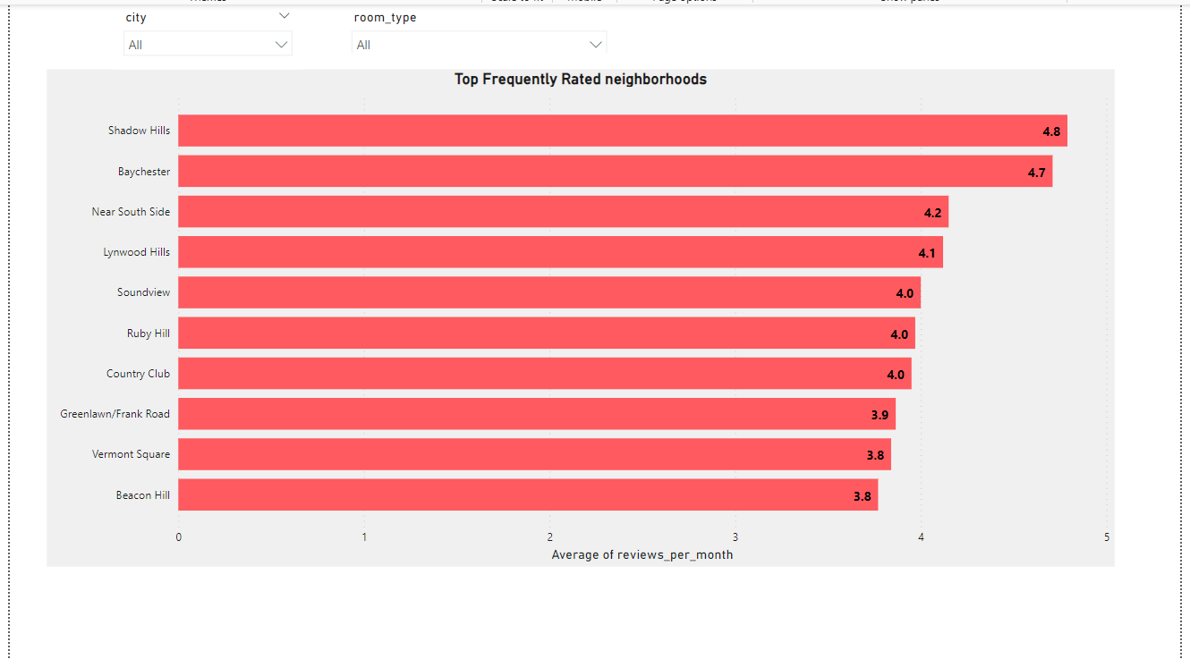
Top 10 most frequently reviewed listings in a specific neighborhood
Shadow Hills has the highest average number of reviews per month
Beacon Hill has the lowest average number of reviews per month
﻿Across all top10 neighborhoods, Average of reviews per month ranged from 3.5 to 5 approximately

Slide 14
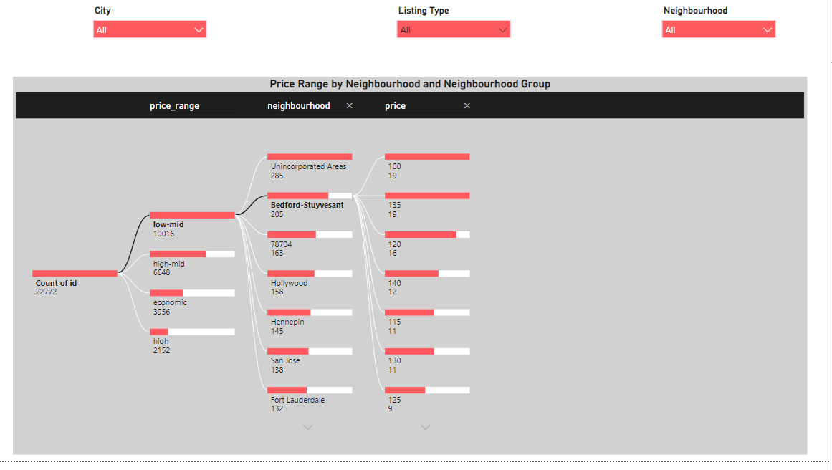
Breakdown of neighborhoods based on different price ranges along with the corresponding number of listings
Decomposition tree helps in analyzing the hierarchy and understanding how the price are determined based on neighborhood
Count of host id represent count of host

Slide 15
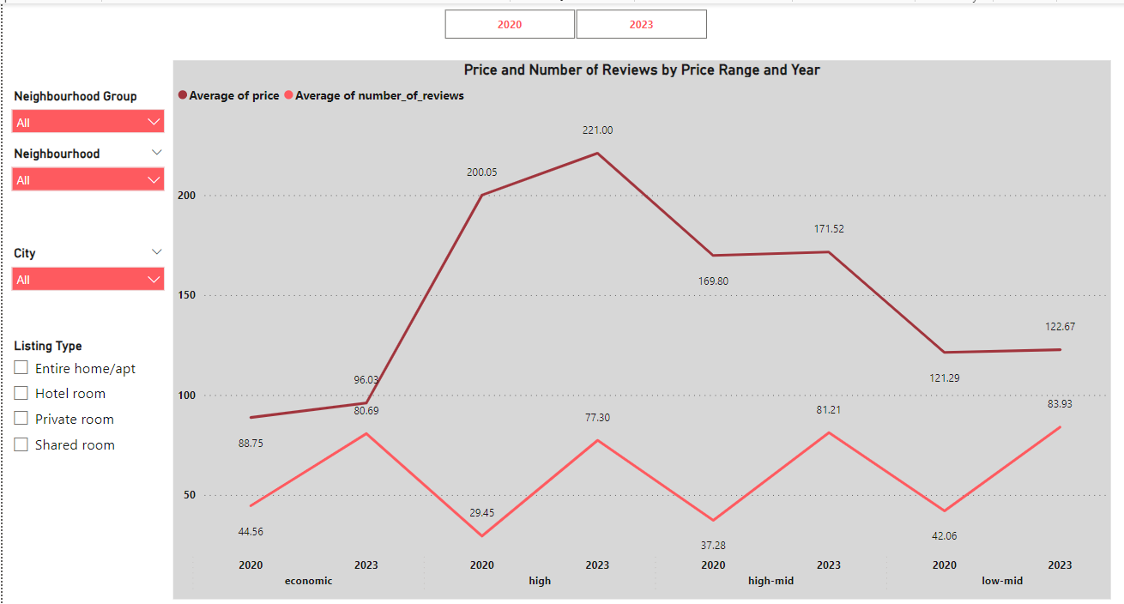
Growth in the number of listings and reviews evolved throughout the year within each pricing range
Average of price and total Average of number_of_reviews are positively correlated with each other.﻿﻿﻿ ﻿﻿
﻿﻿Average of price for 2023 and 2020 diverged the most when the price_range was high.
As prices are increased, we see increase in number of reviews .

Slide 16
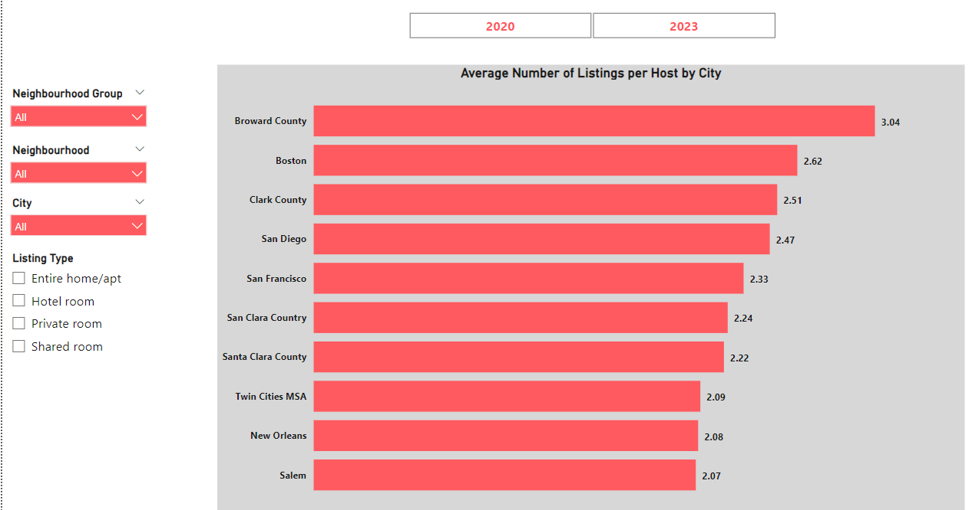
Average number of listings managed by individual hosts in a particular city?
At 3.04, Broward County has the highest average of host_listings_count and is 46.88% higher than Salem, which has the lowest Average of calculated_host_listings_count at 2.07.
﻿Across all 10 city, Average of calculated_host_listings_count ranged from 2 to 3 approximately .

Slide 17
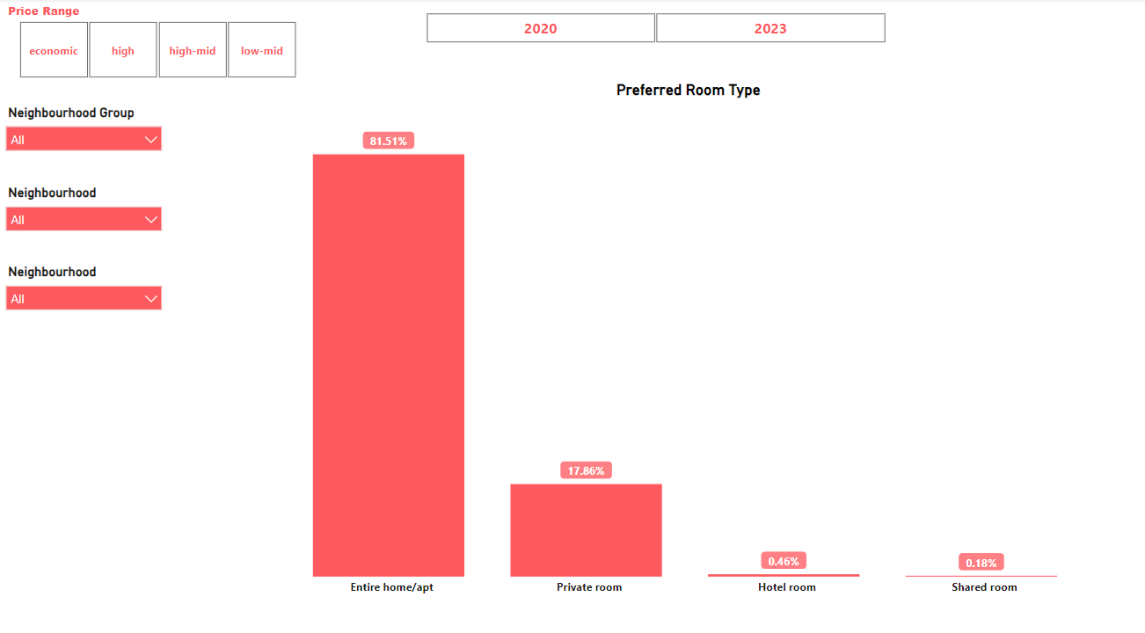
Popularity trend :
Entire home/apt is the most popular followed by private rooms.
Demand of hotel room and share room is negligible.

Slide 18
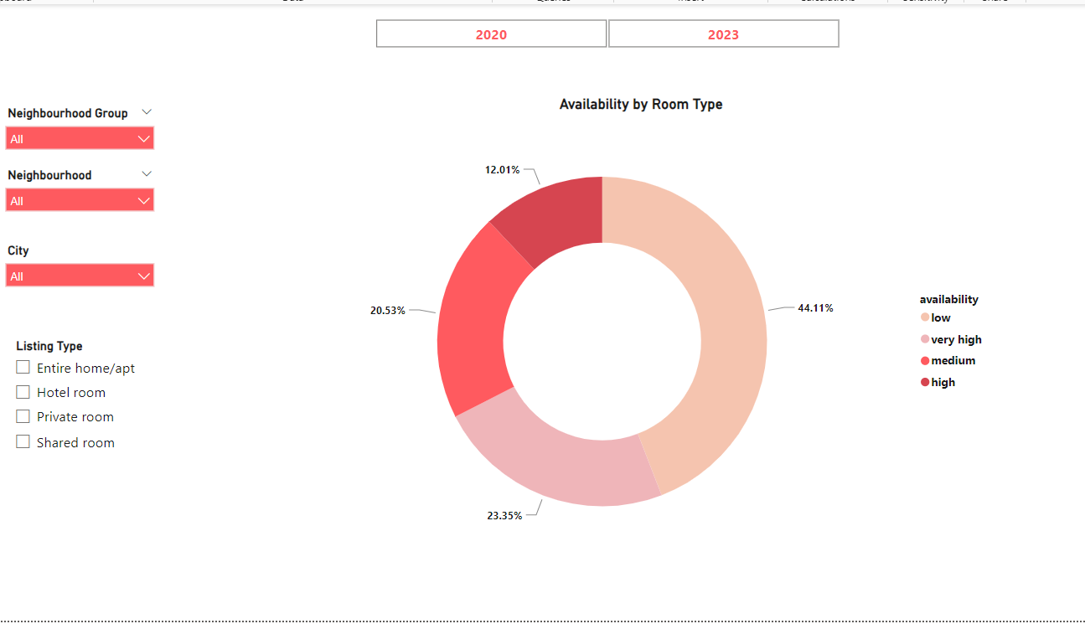
Availability by Room Type
Low availability describe the maximum occupancy
Shared rooms has highest availability (70%)but lowest in demand followed by private rooms (45%)
Entire rooms have low availability approximately 40% and always in high demand.
Hotel rooms have high availability of 37% (approx.)

Slide 19
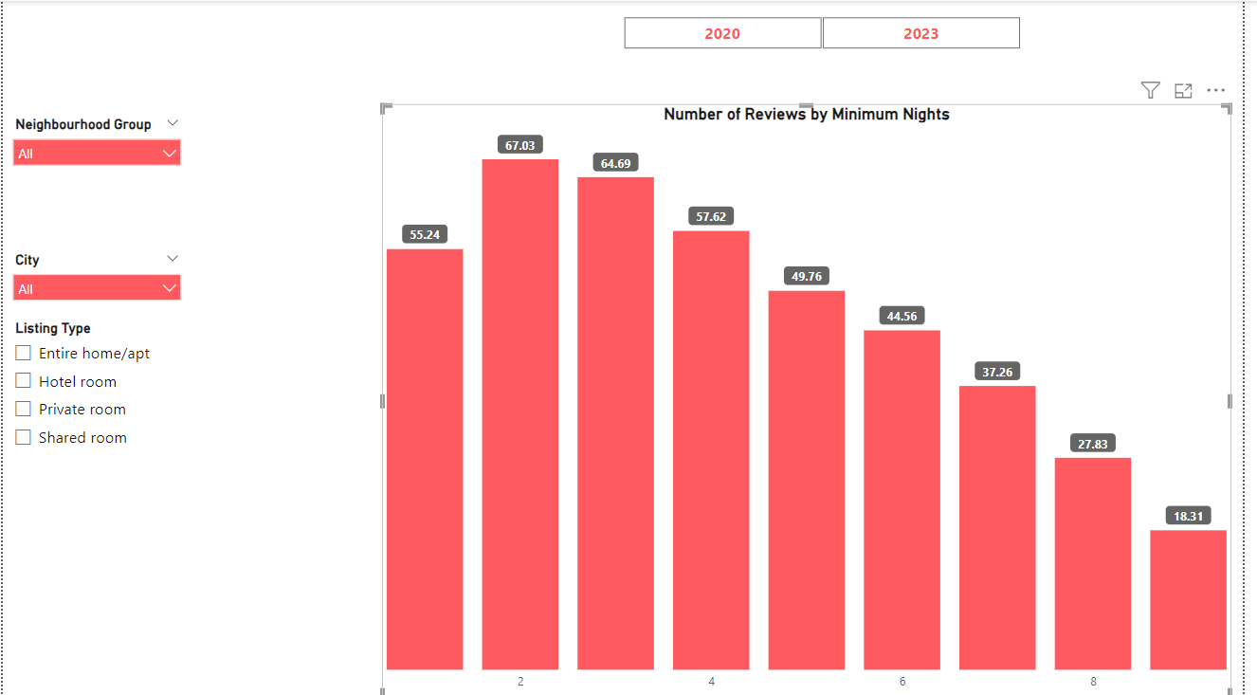
Number of reviews based on minimum nights spent in Airbnb
Accommodations where People staying for 2 to 3 nights have received more number of ratings as compared to longer stays in the rented place .

Slide 20
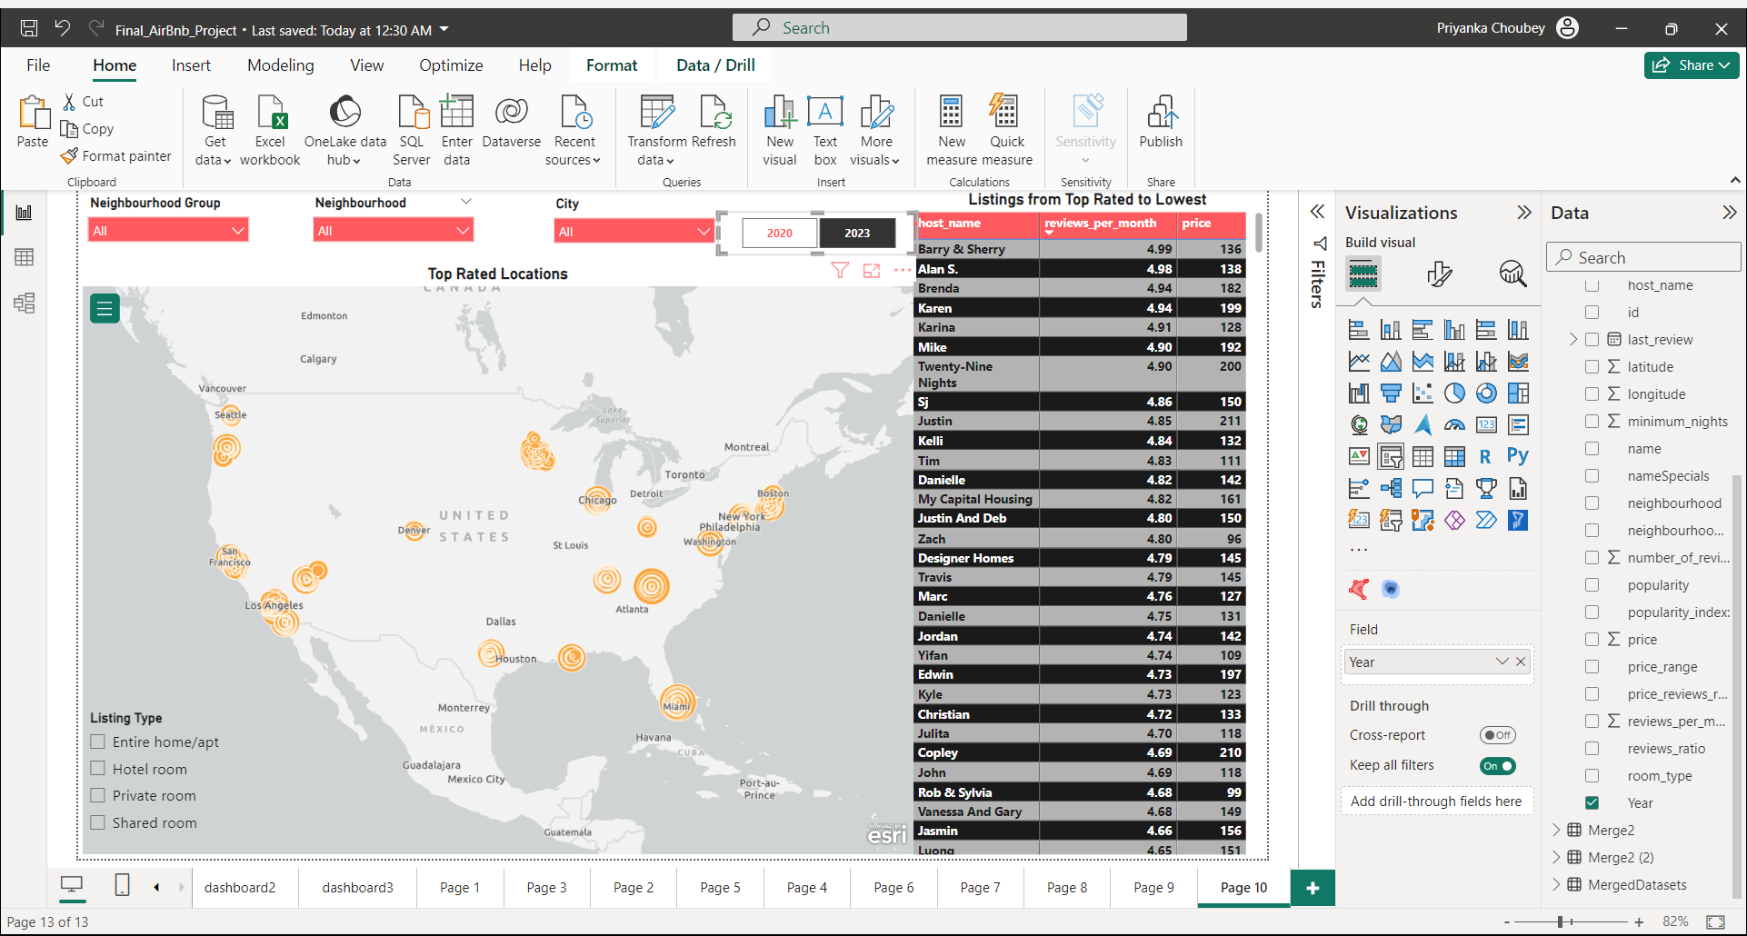
List of top rated and least rated Host
Listing of host’s names based on top reviews by customers , city, room type and neighborhood it belongs .
Ex: Berry & Sherry , Alan are top rated hosts.

Slide 21

STORY
&
DASHBOARD

Slide 22
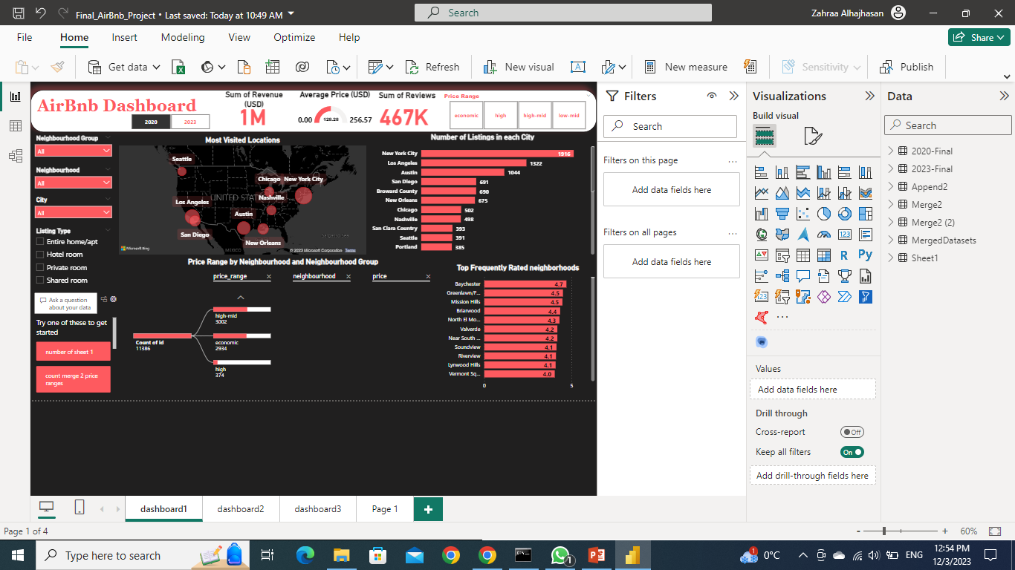
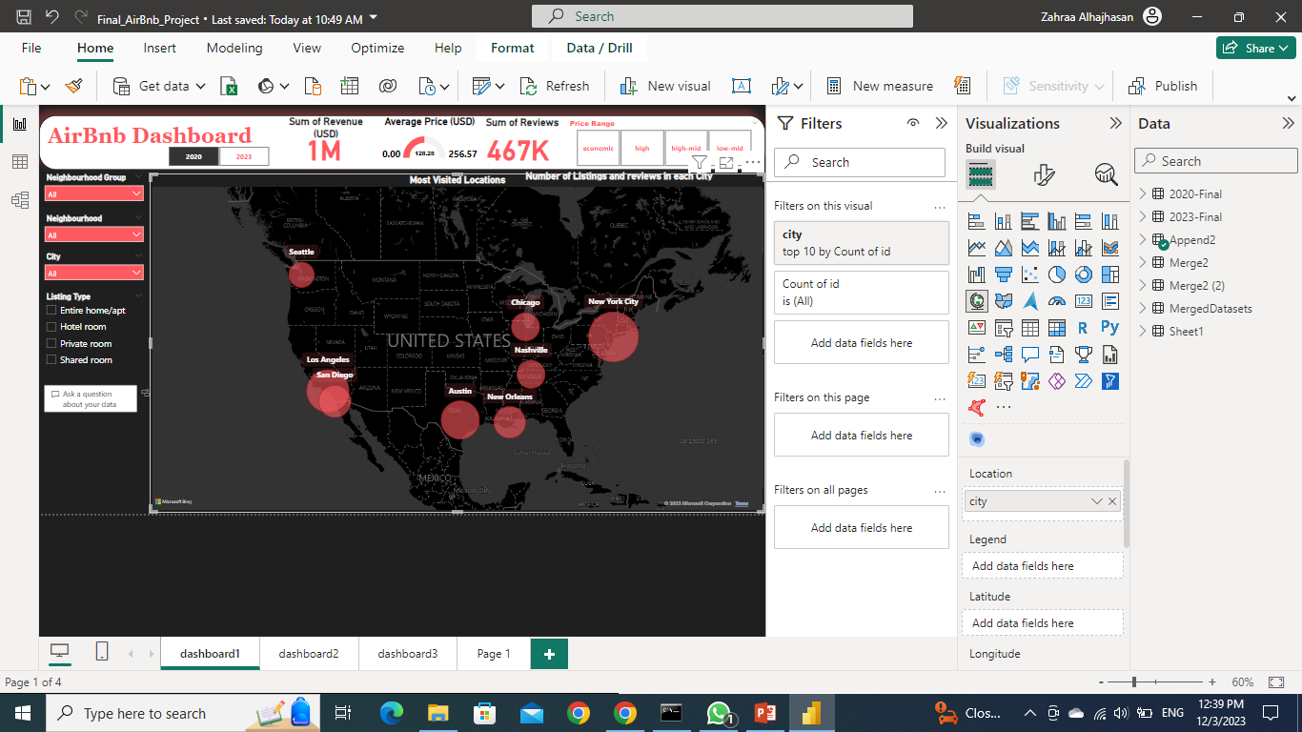
STORY 1
For individuals planning to buy a house, the challenge is to identify neighborhoods with high demand and revenue potential. This involves analyzing various factors, including local market trends, property value growth from 2020 to 2023, and key amenities in different areas. The objective is to make informed decisions on where to invest based on future growth prospects and current market dynamics.
First, here are the the most visited cities in the USA.
Looks like New York, Los Angeles, Austin, San Diego has the highest number of listings.
Set San Diego as the target city.

Slide 23
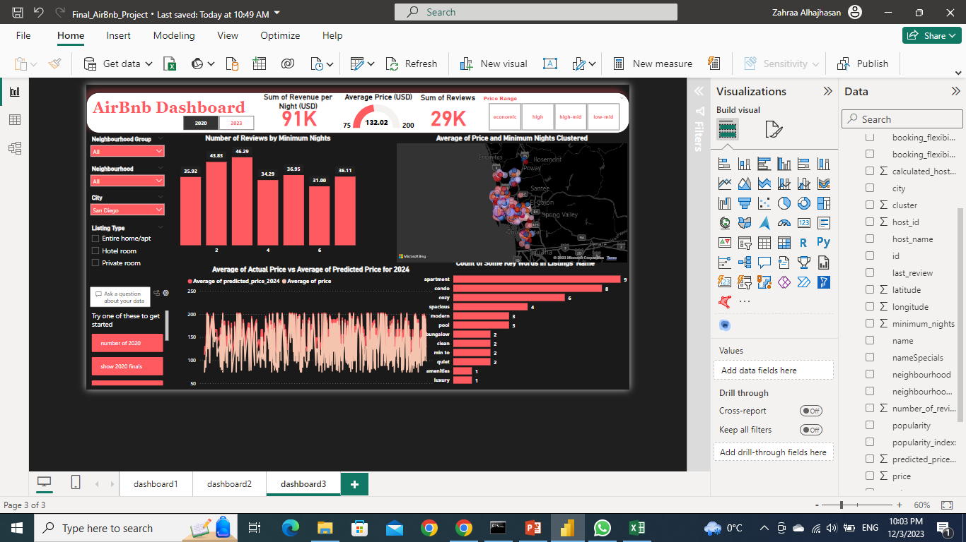
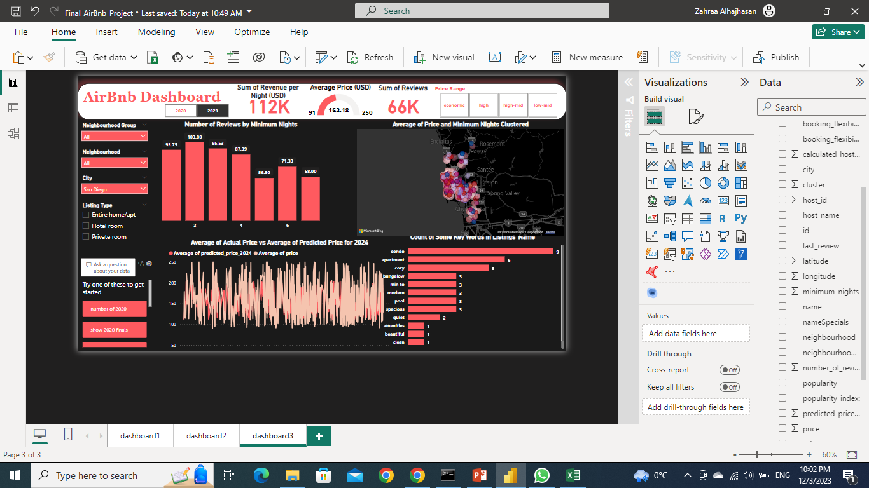
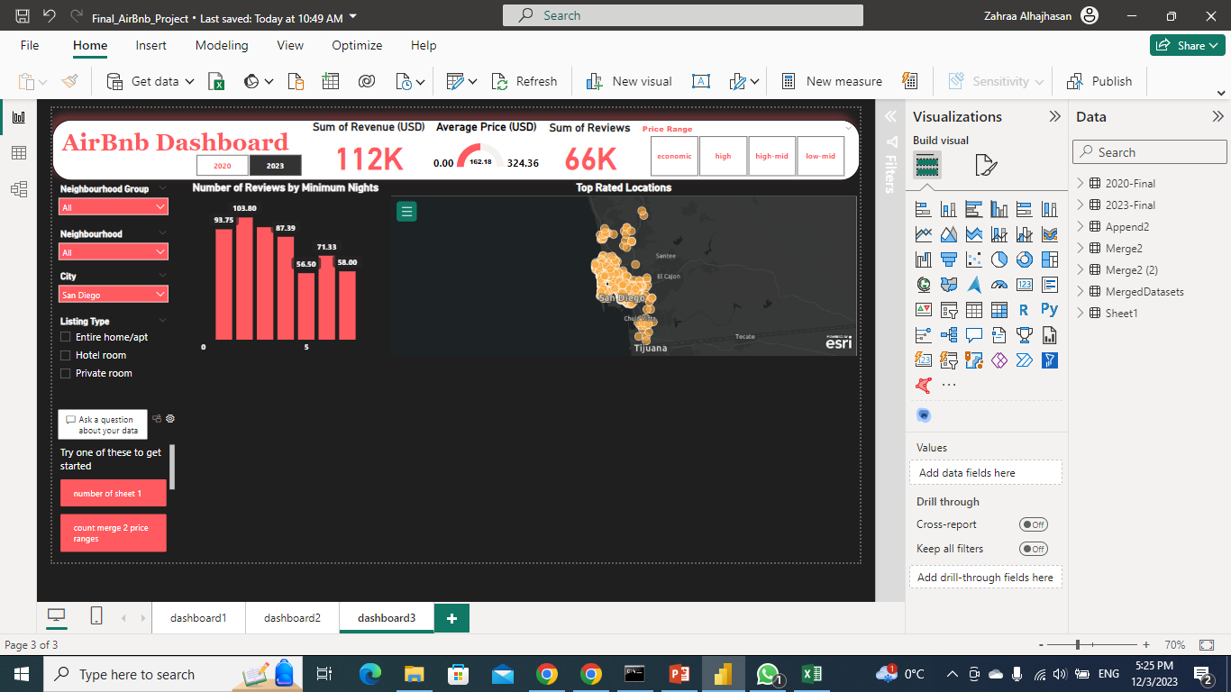
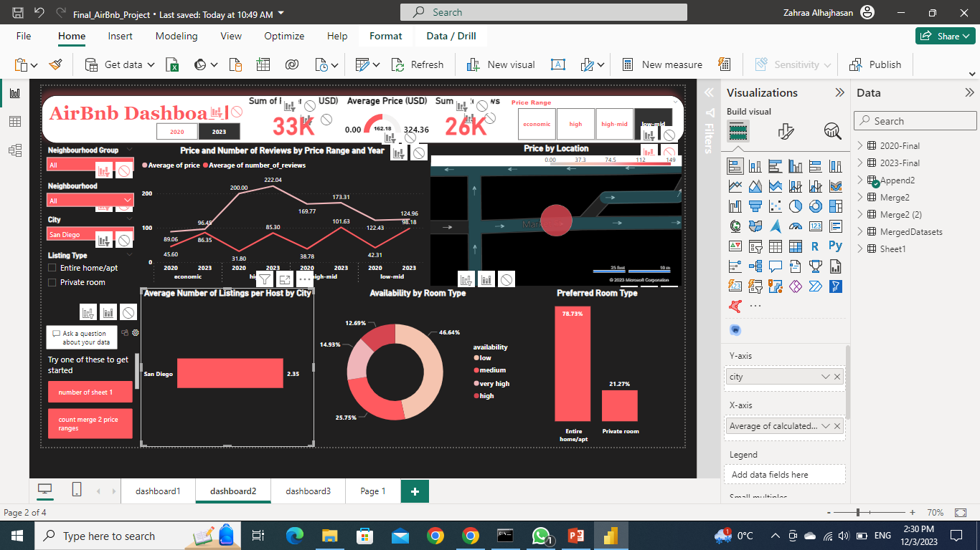
After selecting San Diego, the chart shows that it has 2.35 listings per host, which gives a good hint about the potential of revenue and expand of the business.
Also, these are the statistics for San Diego per night and the growth from 2020 to 2023 for same listings! Looks good.

Slide 24
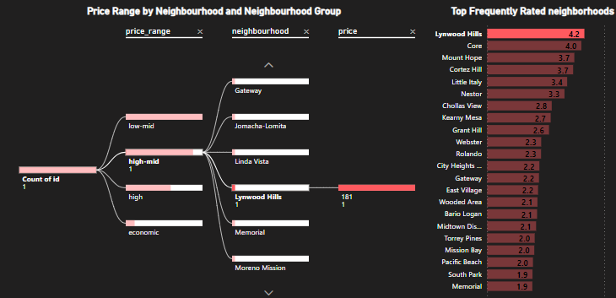
Now this is list of neighborhoods that are frequently rated and have highest number of reviews per month, we will choose Lynwood Hills.
But, Lynwood Hills has only 1 listing, which is not a good reputation for the neighborhood.

Slide 25

While search to find a neighborhood that match the expectations.
Finally, will choose Grant Hills
Now that we have selected a neighborhood, we can start studying the pricing strategy and customer preference.
But First, I will show case a story for the second problem statement and then study the pricing strategy as both will have the same steps.

Slide 26
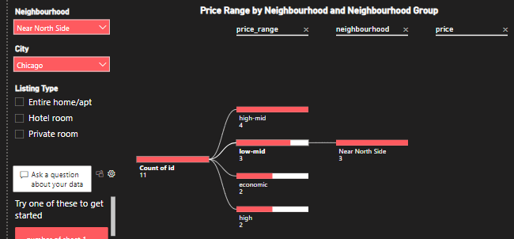
STORY 2
In the context of owning a house and potentially renting out a room, the challenge is to develop an effective pricing strategy that aligns with the local real estate market, considering factors such as property features, neighborhood demand, and guest preferences. The goal is to optimize the property's rental potential while maintaining competitiveness in the market.
There’s already an apartment in Chicago, near North side.
Will set the filters and have an overview of the statistics in this neighborhood.
Looks like there’s 11 listings in this neighborhood.

Slide 27
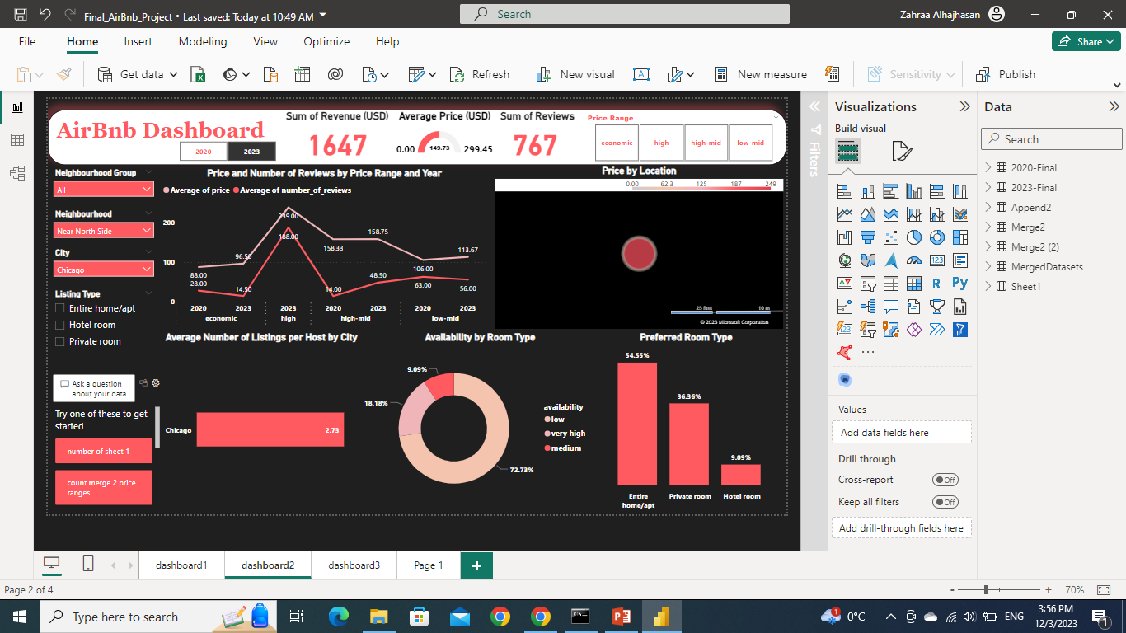
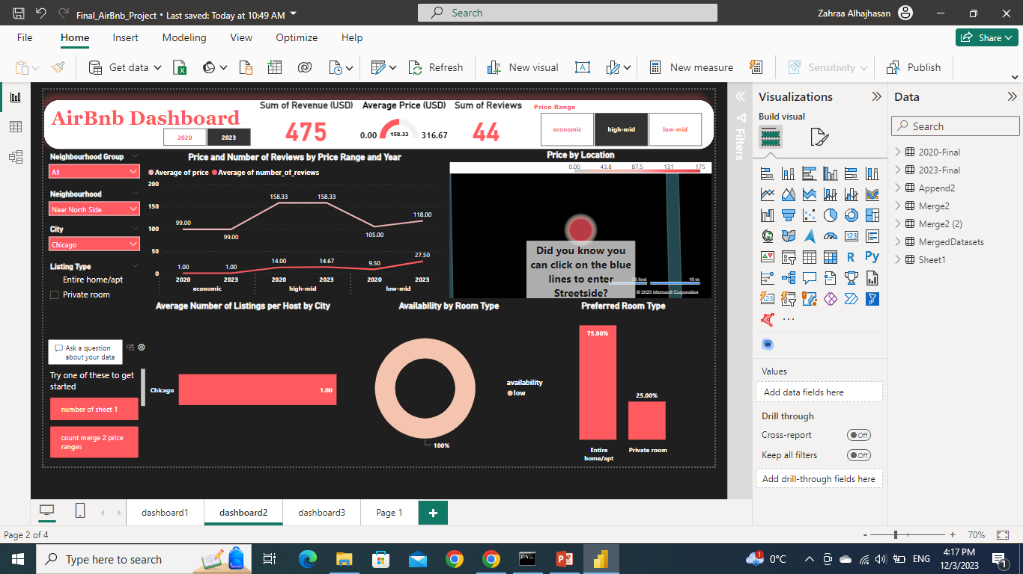
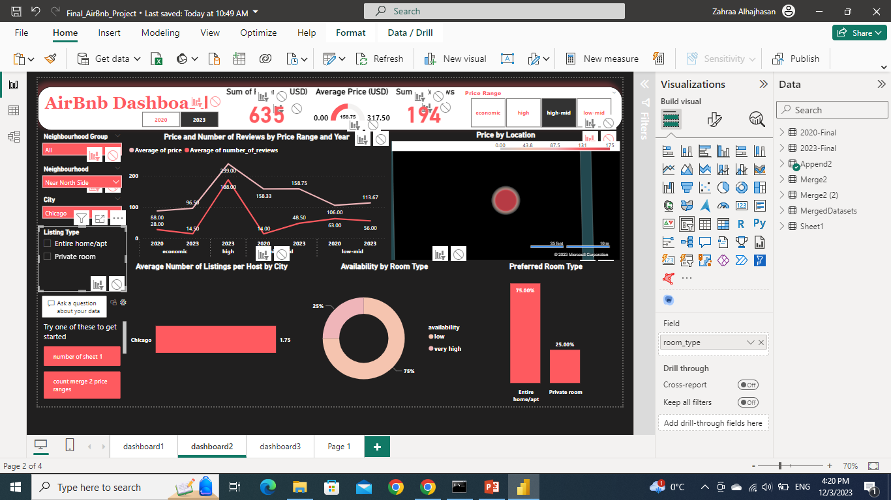
Now it’s time to start studying the pricing and customer preference for both stories
will continue with Chicago example and it applies for the earlier story.
This chart shows the growth in each price range and number of reviews, looks like all categories have a potential for growth.
According to the listing conditions, my price must be in the mid range. As for growth and the target high-mid range looks good.
set the filter for high-mid
Now, it’s time to check what type of room is preferred to rent by visitors.
Looks like 75% of listings are for entire home
And availability is low for those listings which means that it’s booked year round.

Slide 28
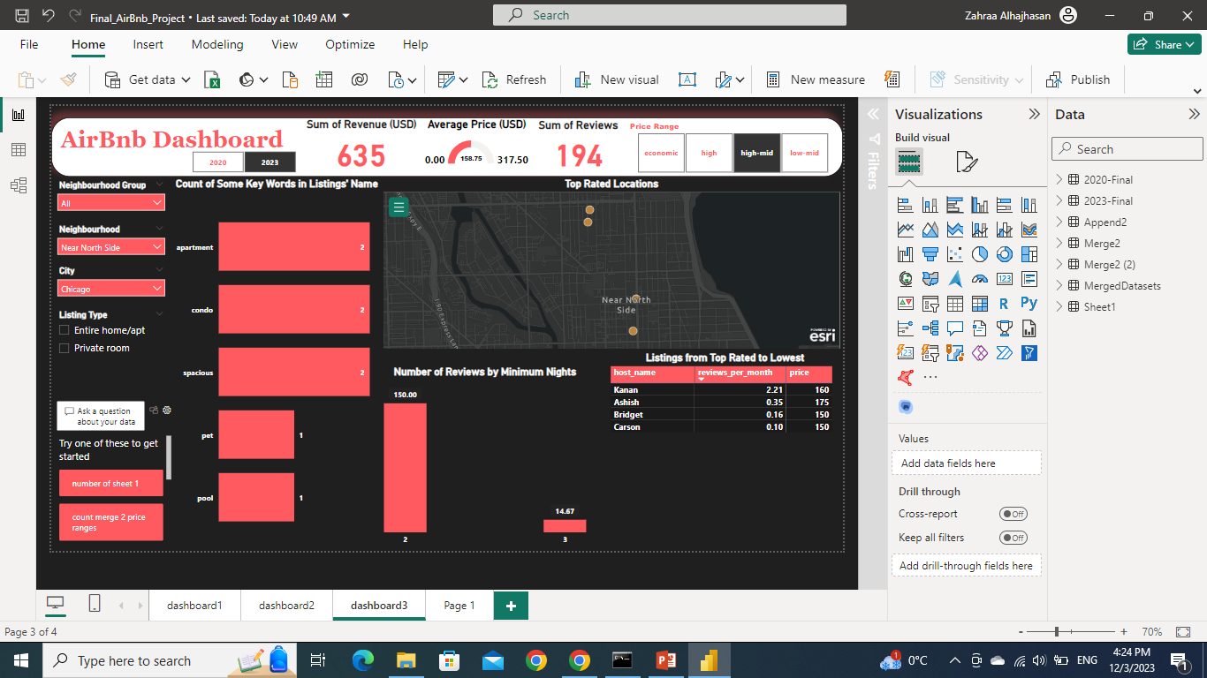
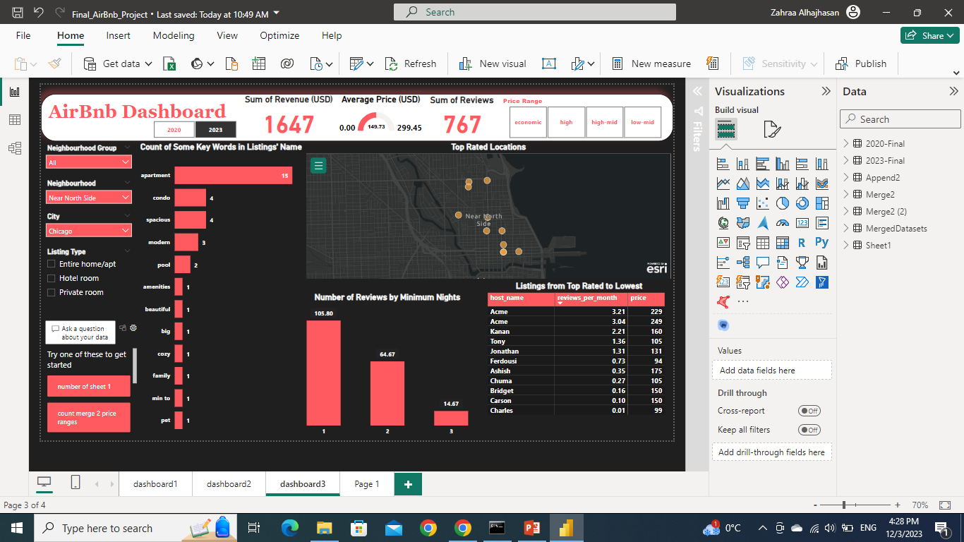
When the minimum nights was 2 nights, the reviews were way more than that when the minimum nights were 3 nights.
So, it’s a good idea to set the minimum nights to 2 or 1 night.
Here are some special words that are present in other listings. Key words like apartment, condo, spacious, and modern have the biggest percentage when naming the listing.
One can take that into consideration when posting my listing on AirBnb.

Slide 29
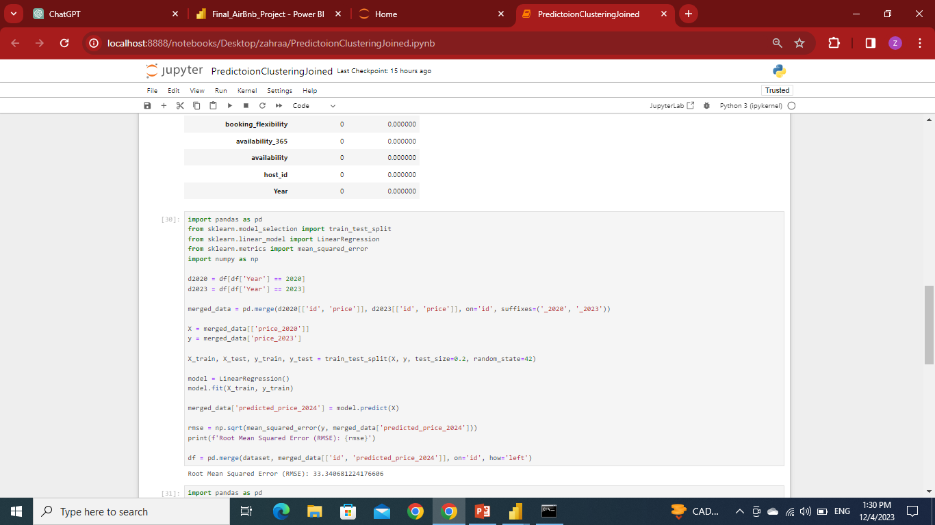
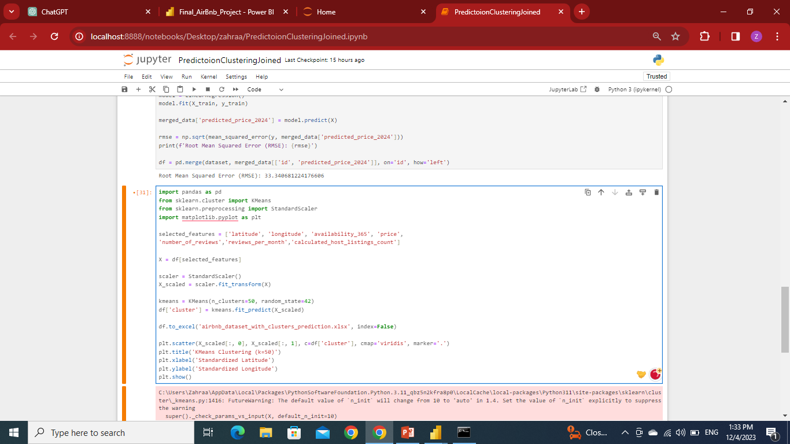
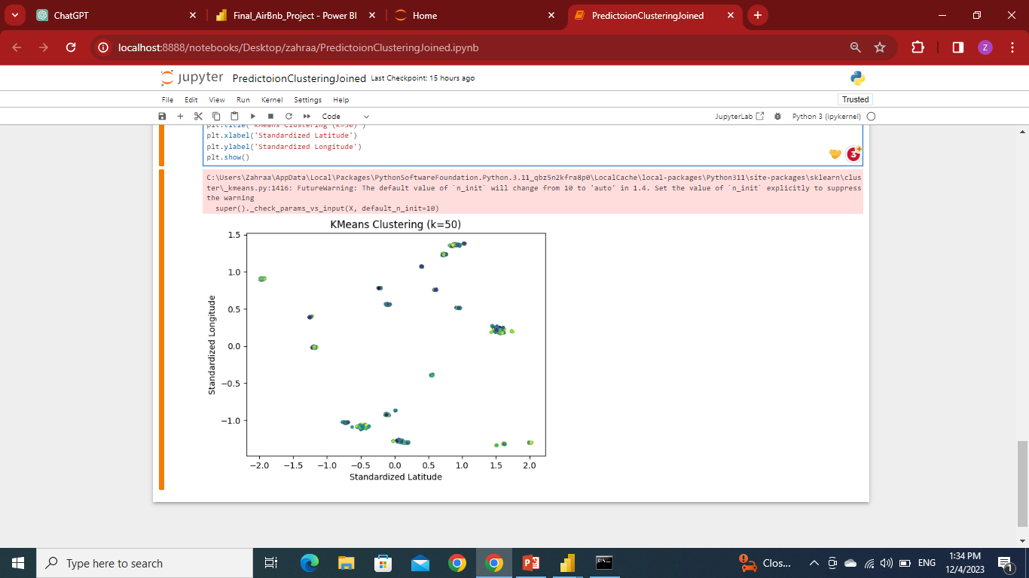
Prediction and Clustering
We found that it would be beneficial to add a prediction and clustering step.
Prediction is implemented using linear regression after a lot of trials using ARMA, ARIMA, and SARIMA forecasting models and got 55 rmse.
Now, the accuracy of this model is about 67%.
For the clustering we used K-means with k=50 to cluster listing according to a lot of parameters.

Slide 30
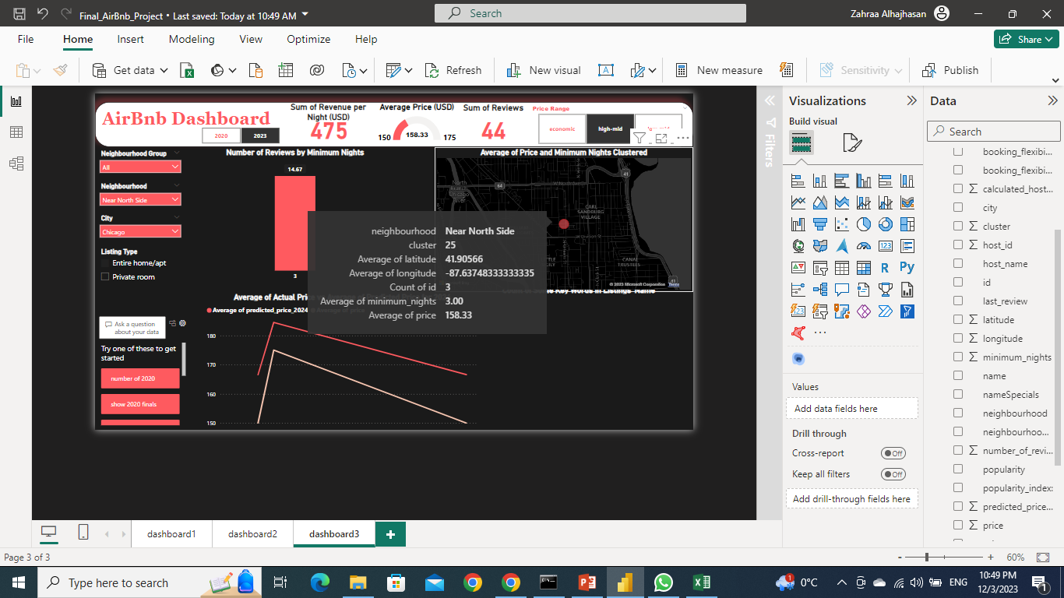
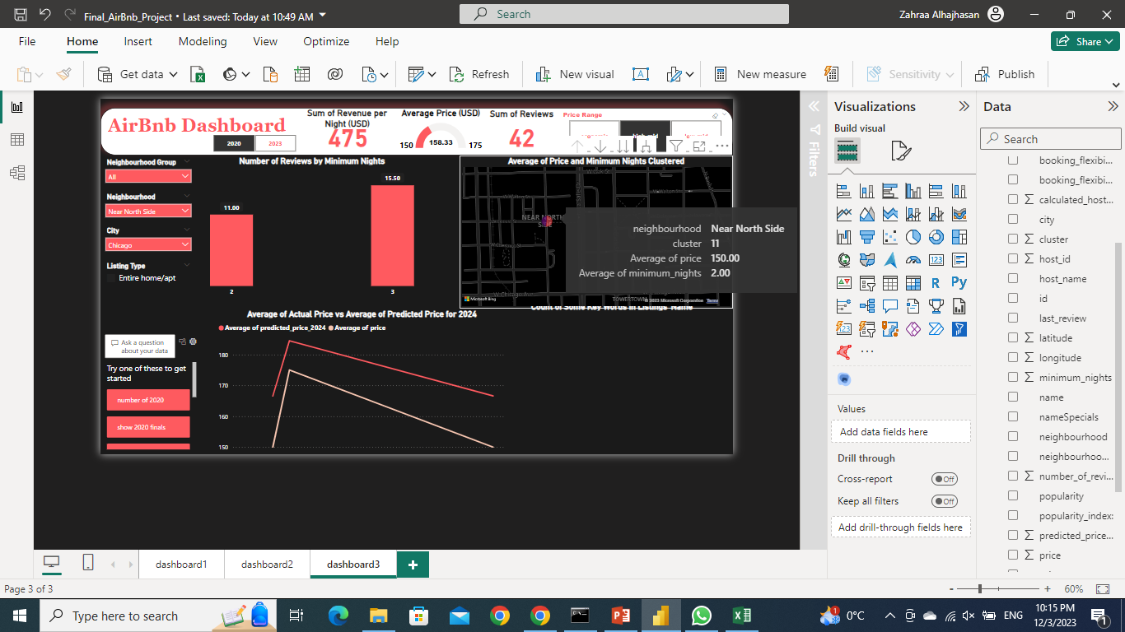
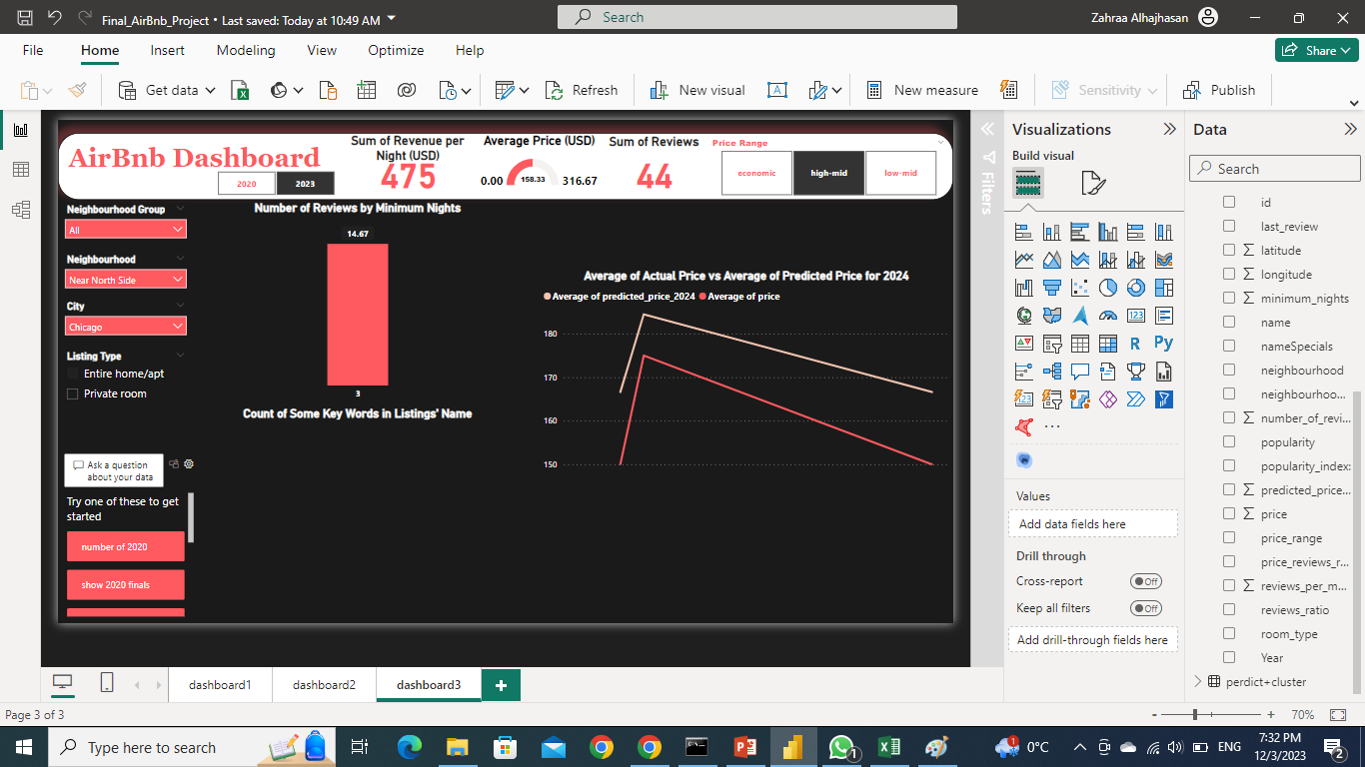
In this neighborhood, there’s a clusters to compare the prices and get a clearer view of average prices in the neighborhood and average minimum number of nights.
Here is the average, minimum, maximum price of the neighborhood.
One must keep the price lower than maximum for competitiveness.
Finally, in this chart there’s forecasted price for 2024, which give a glimpse of the growth of the listings in this neighborhood.
The chart shows that the listings have a potential for growth in future according to our prediction model.
One must keep in mind that accuracy of this model is 67%, but it’s a good way to assure the choice of neighborhood and pricing.

Slide 31
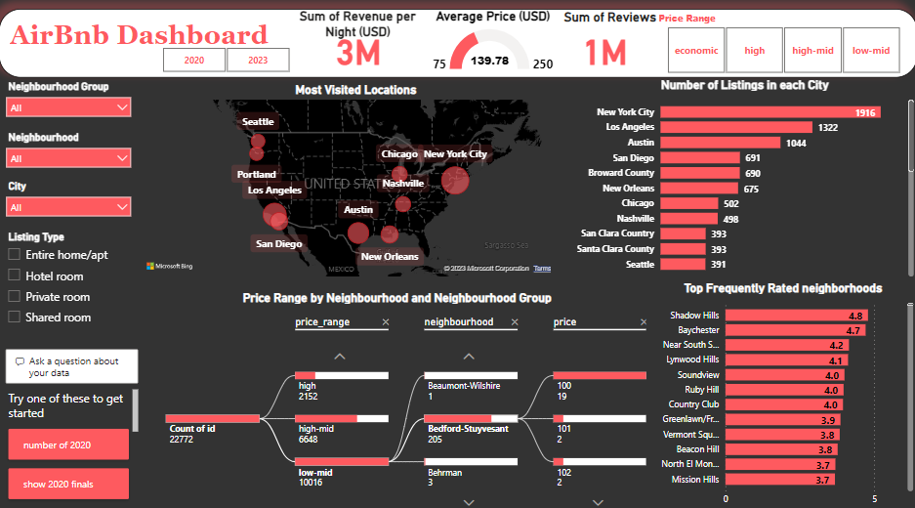
DASHBOARD

Slide 32
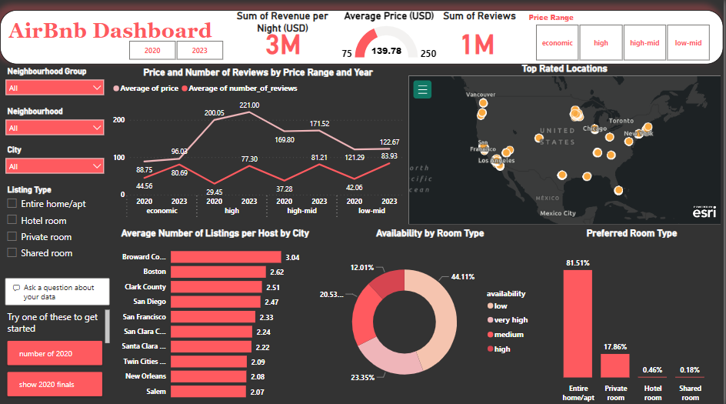

Slide 33
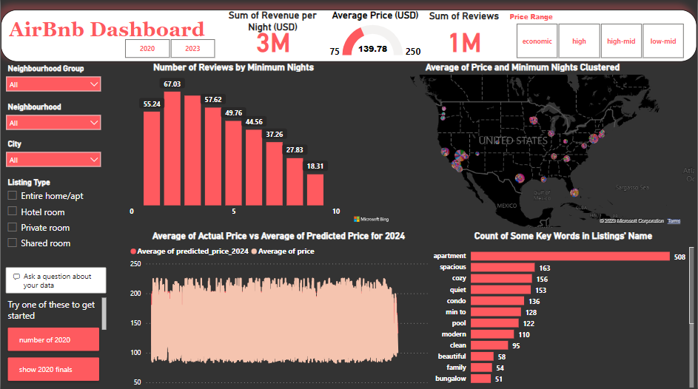

Slide 34
References:
Dataset: https://www.kaggle.com/
Source 2: http://insideairbnb.com/get-the-data/
Clean, transform, and load data in Power BI
https://learn.microsoft.com/en-us/training/modules/clean-data-power-bi/
Types of insights supported by Power BI
https://learn.microsoft.com/en-us/power-bi/consumer/end-user-insight-types
Use grouping and binning in Power BI Desktop
https://learn.microsoft.com/en-us/power-bi/create-reports/desktop-grouping-and-binning
UNION
https://learn.microsoft.com/en-us/dax/union-function-dax
Create key influencers visualizations.
https://learn.microsoft.com/en-us/power-bi/visuals/power-bi-visualization-influencers?tabs=powerbi-desktop#considerations-and-troubleshooting
Power BI and Esri ArcGIS
https://powerbi.microsoft.com/en-ca/power-bi-esri-arcgis/
References

Slide 35

Thank You

